Slide 1


Alignment of two Fragaria iinumae genomes
Mamta Kajal
Anushreeya Gurung

Slide 2
Introduction
Reference genome
Genome sequenced from Fragaria iinumae in 2017
using Illumina Sequencing
is in pseudomolecules form
Query genome
Sequenced from Fragaria iinumae in 2021
Using Oxford Nanopore
is in its raw form (220 Fatsq.gz files)

Slide 3
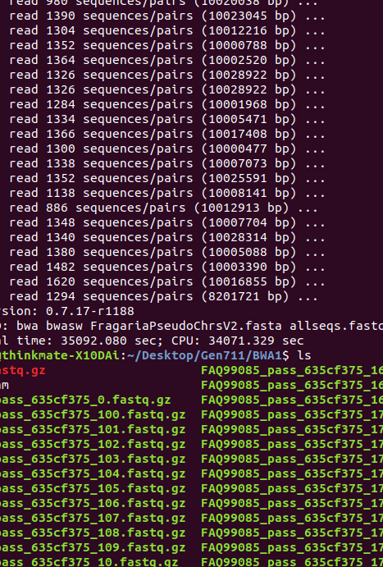
Approaches applied…
Burrow Wheeler Alignment (BWA)is a software package for mapping low-divergent sequences against a large reference genome.
Samtools is a set of utilities that manipulate alignments in the SAM (Sequence Alignment/Map), BAM, and CRAM formats.
Integrated Genome Viewer (IGV) is an interactive tool for the visual exploration of genomic data.

Slide 4
Pipeline
BWA
Indexing reference genome files
BWA
Generating sam files from Fastq.gz files
Samtools
Converting sam files to bam files
Samtools
Samtools
Running stats on bam files
Samtools
Generating graphs and images
IGV
Running bam index files on IGV
Constructing bam index files

Slide 5
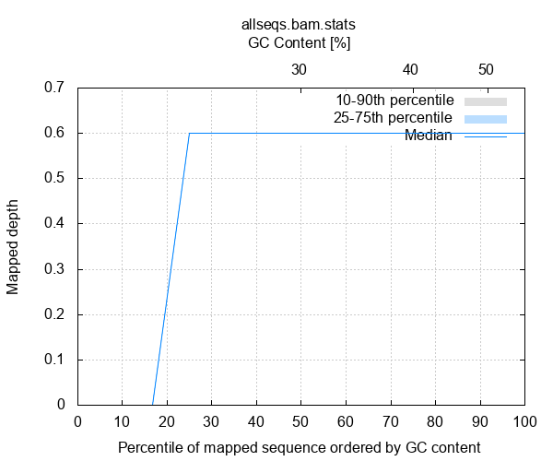
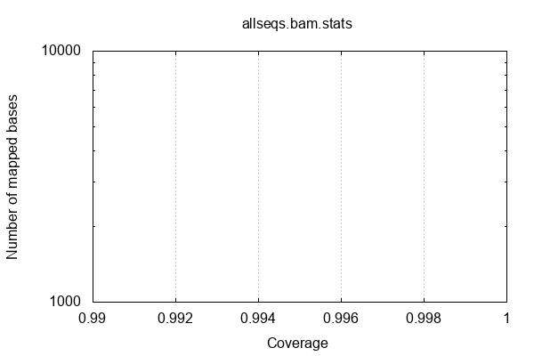
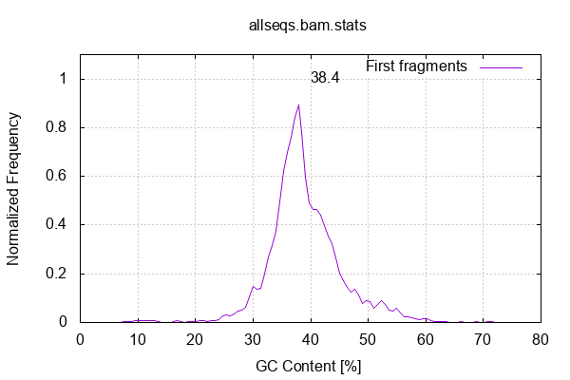
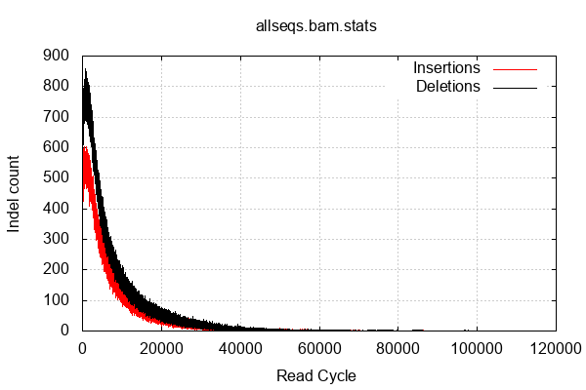
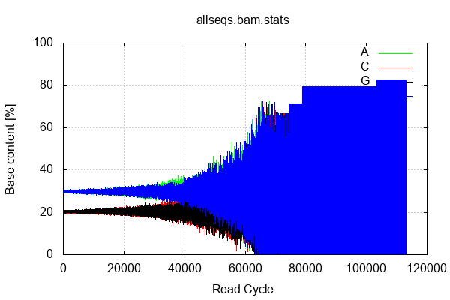
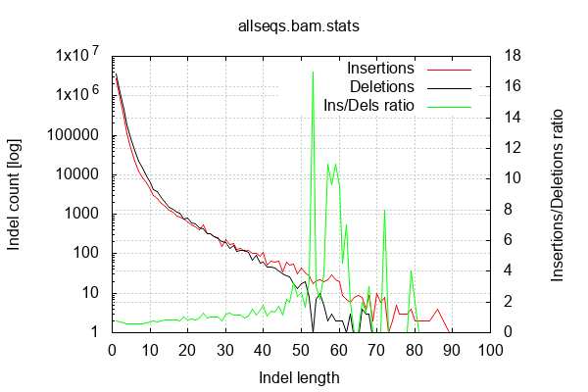
Results (15 concatenated files)

Slide 6
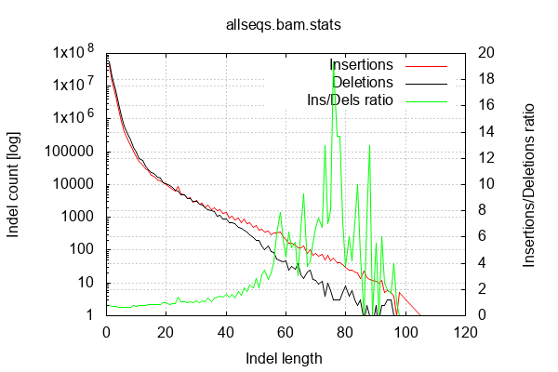
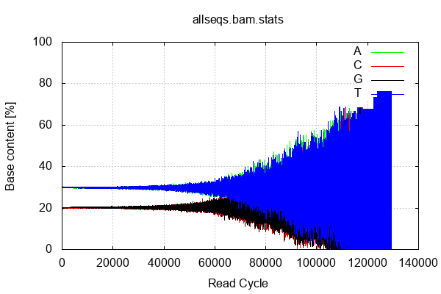
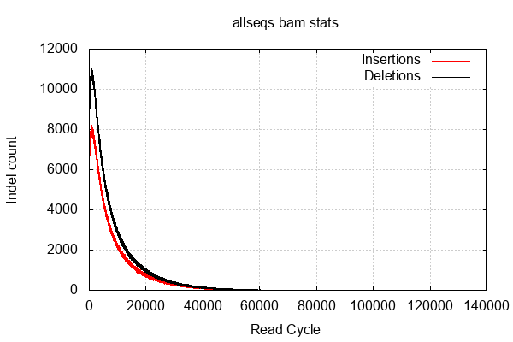
Results (220 fastq.gz files)

Slide 7
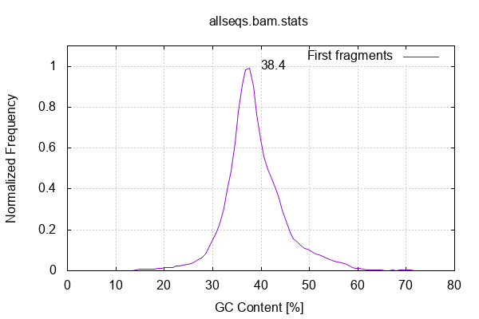
Results (220 fastq.gz files)

Slide 8
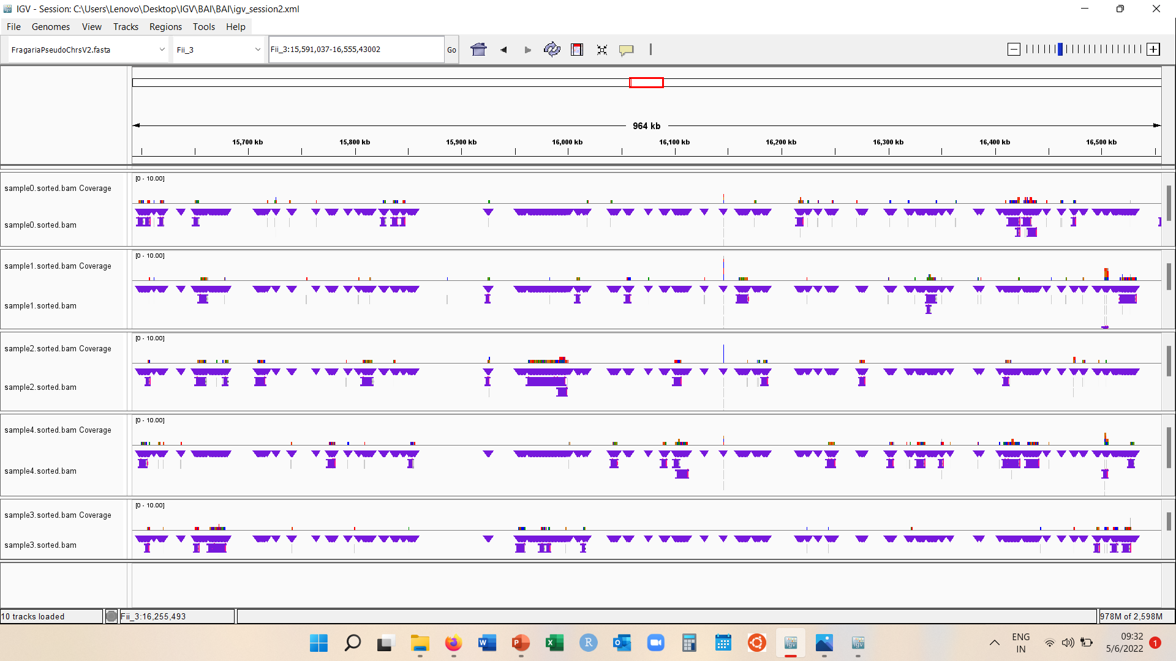
IGV (5 individual Fastq.gz files)

Slide 9
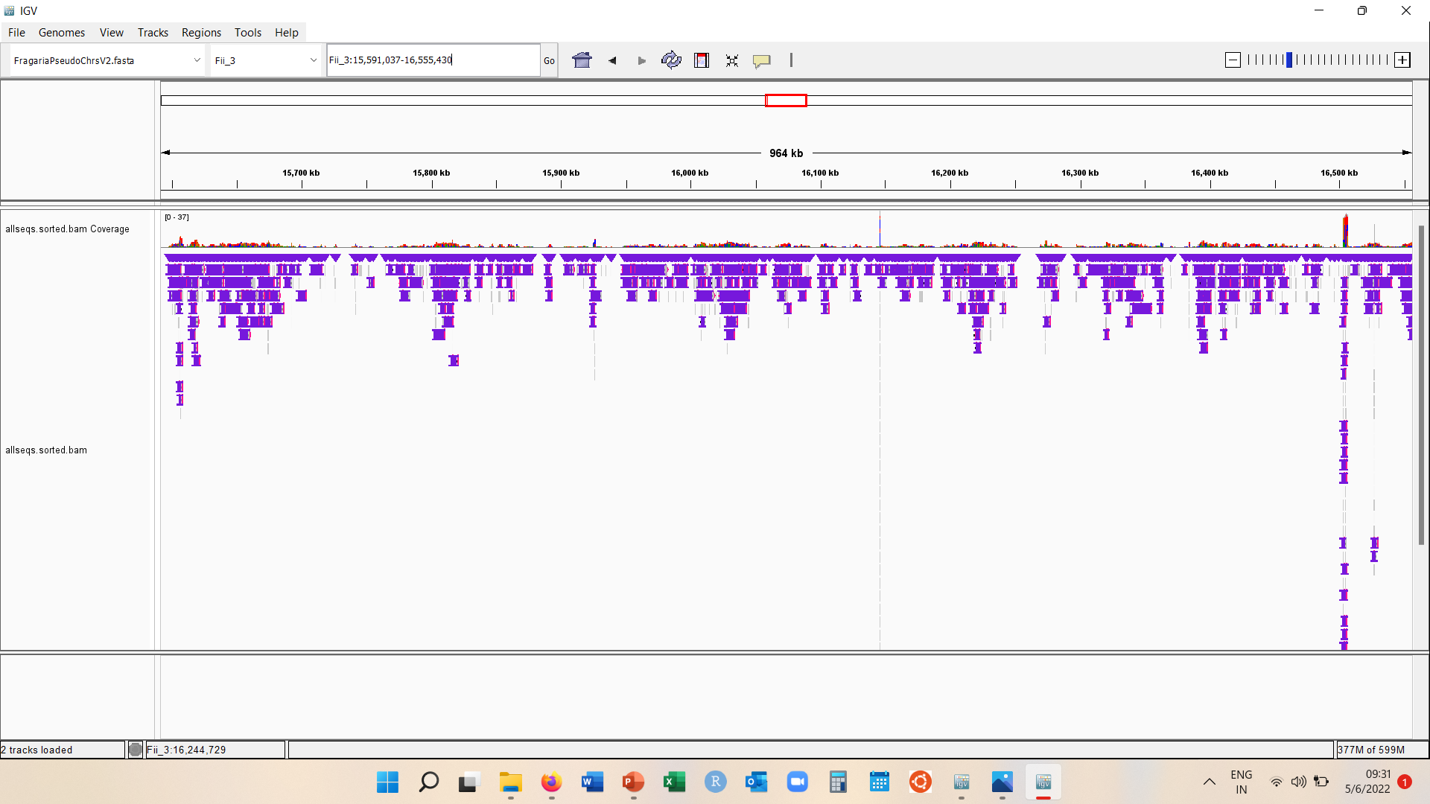
IGV (15 concatenated Fastq.gz files)

Slide 10
Further Work
Deep analysis of all the results
Reason behind no coverage in graphs
View concatenated 220 bam files on IGV

Slide 11
Acknowledgements
Dr Jefferey Miller
Dr Tom Davis
Clayton Ludwig (PhD Candidate)

Slide 12
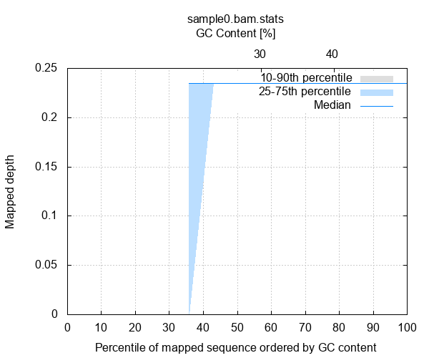
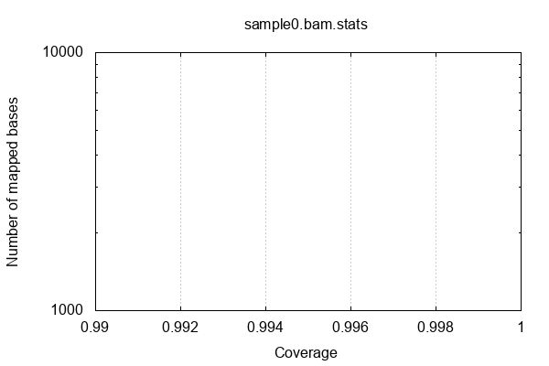
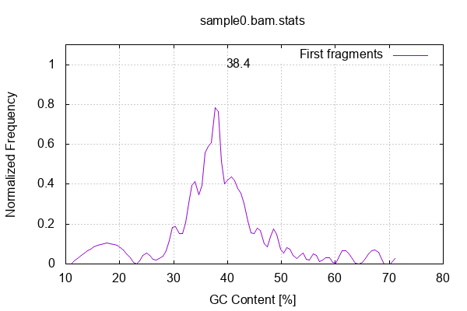
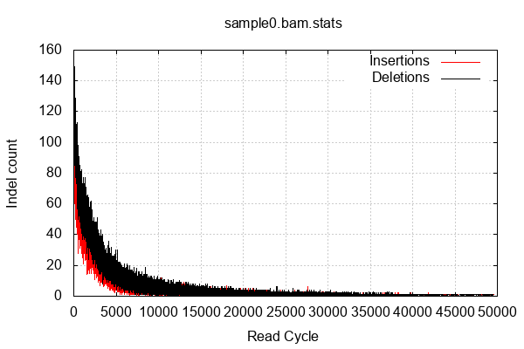
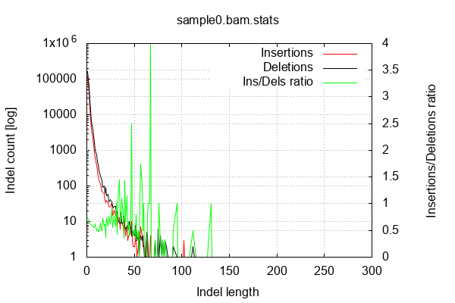
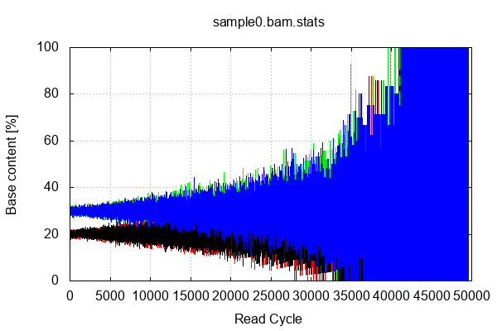
Results- Sequence 0

Slide 13
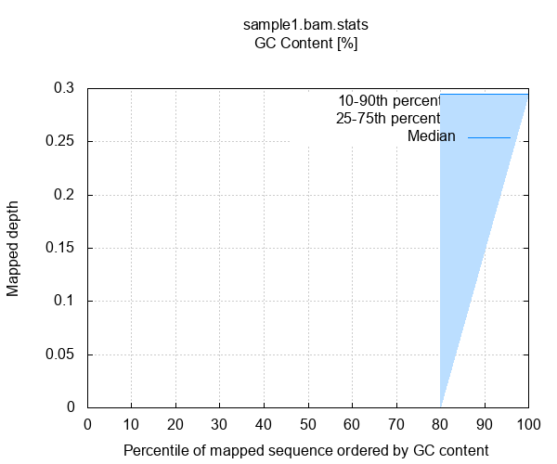
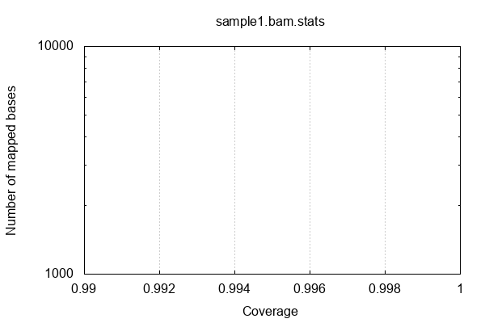
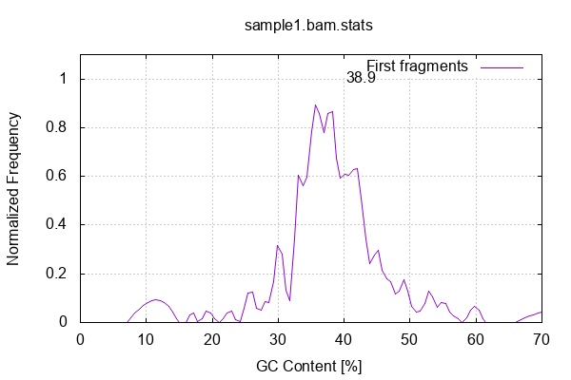

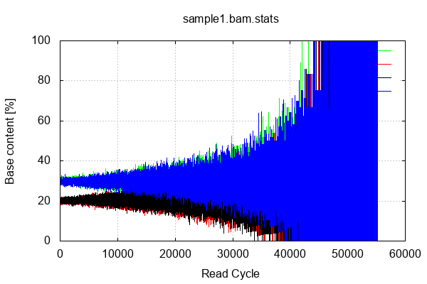
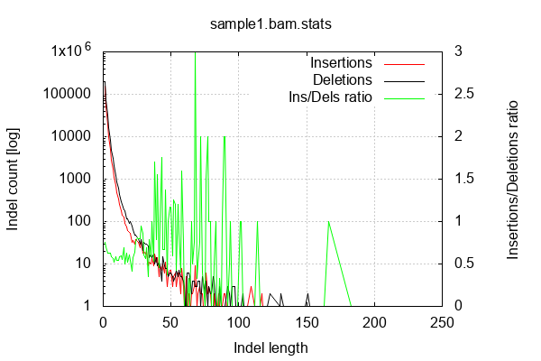
Results- Sequence 1

Slide 14
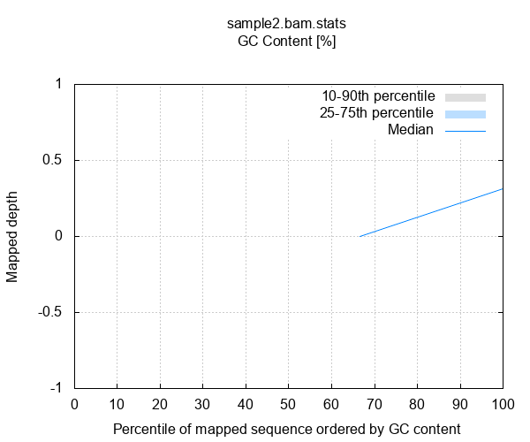

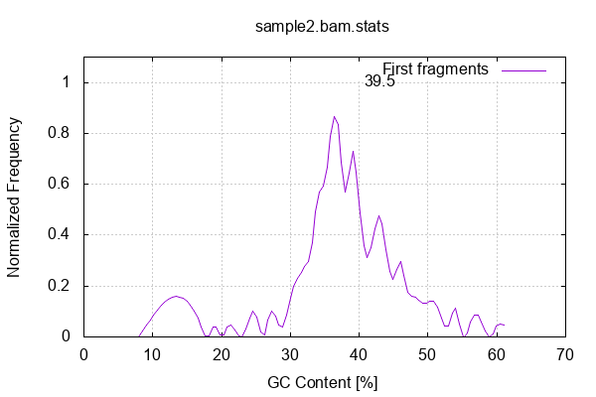
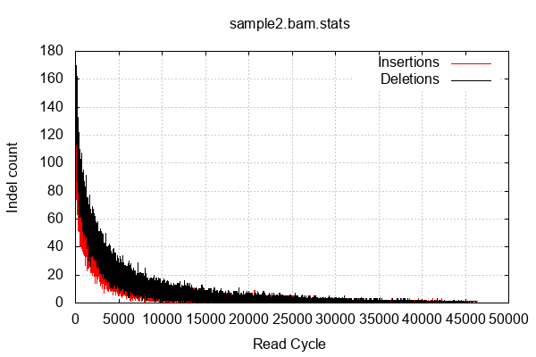
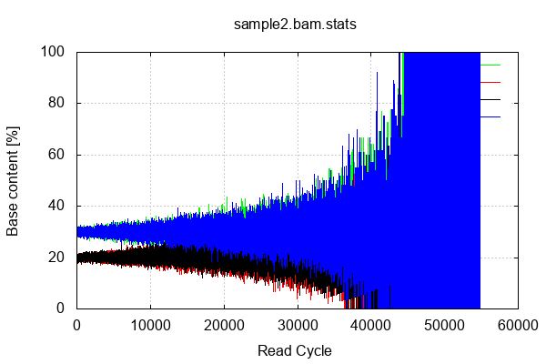
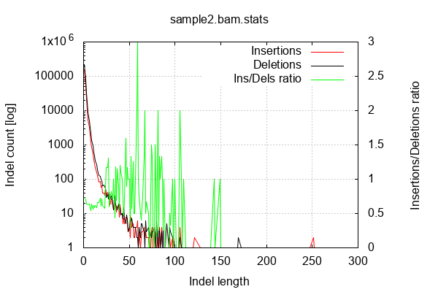
Results- Sequence 2

Slide 15
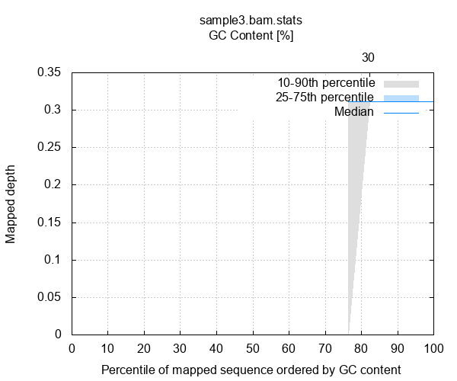
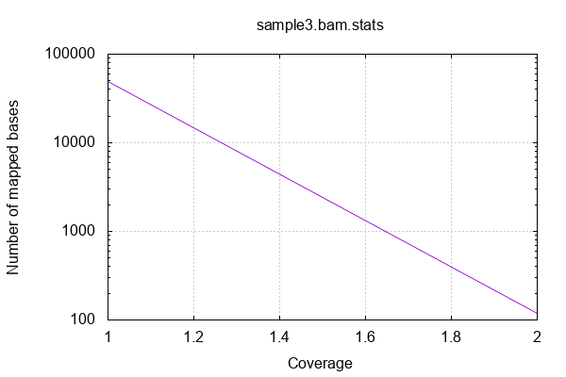
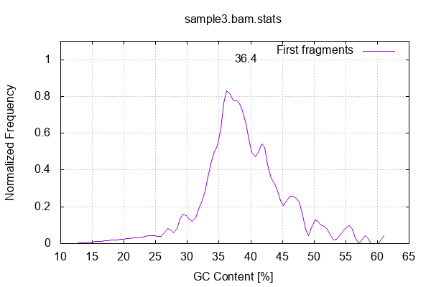

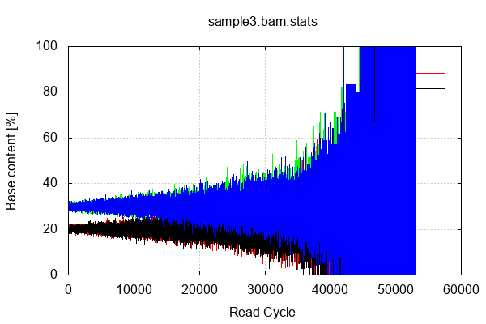
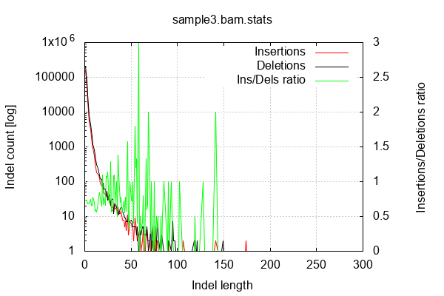
Results- Sequence 3

Slide 16
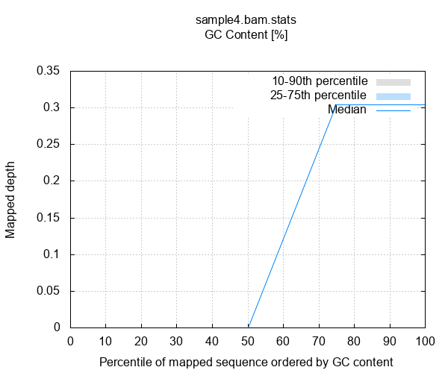

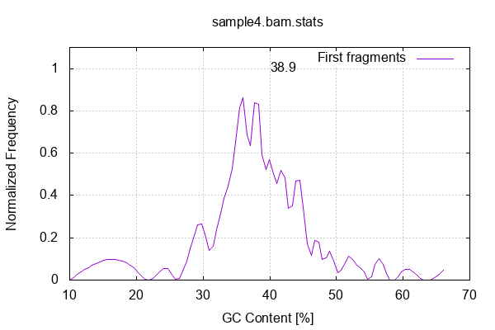
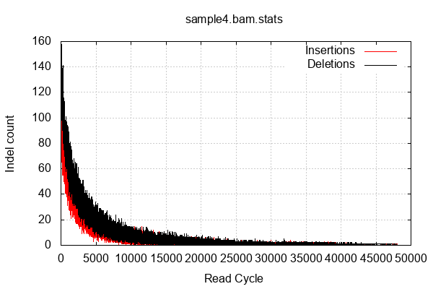
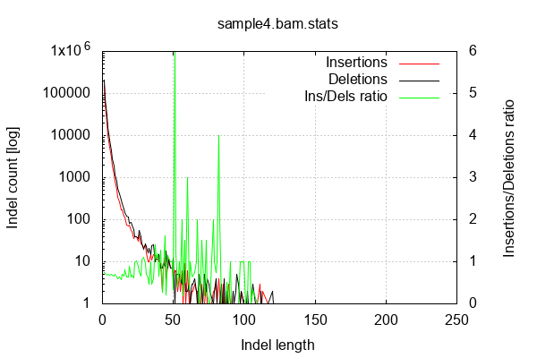
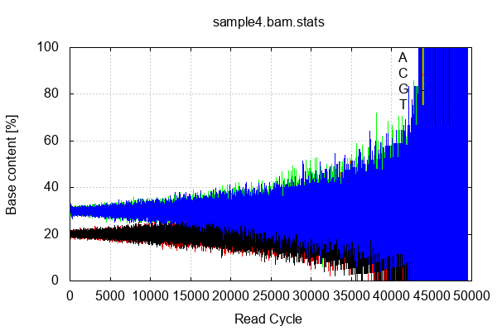
Results- Sequence 4

Slide 17
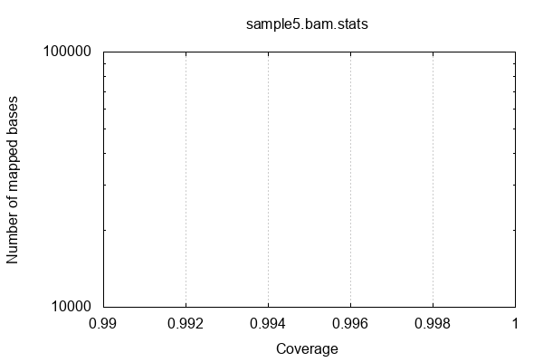
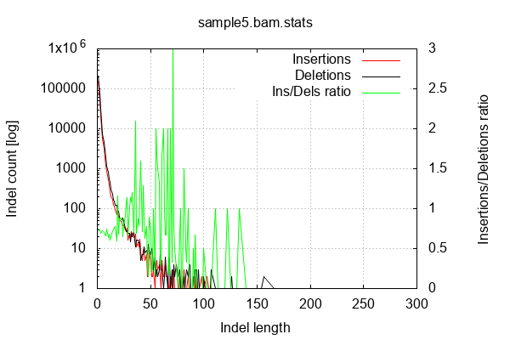

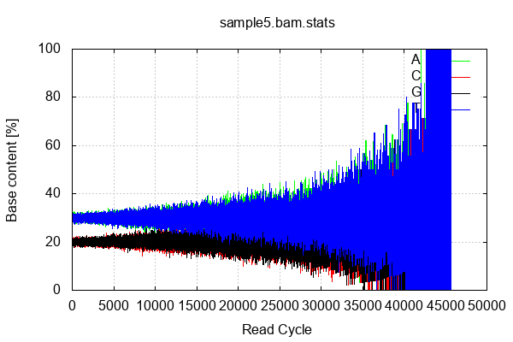
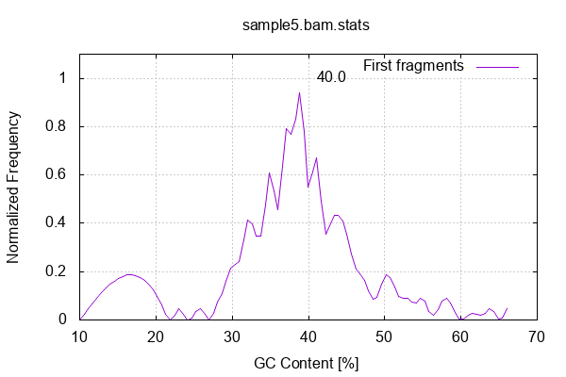
Results- Sequence 5

Slide 18
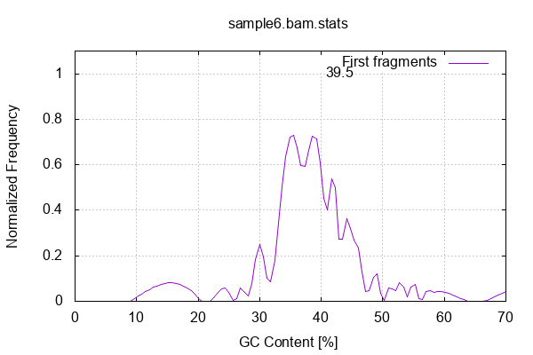
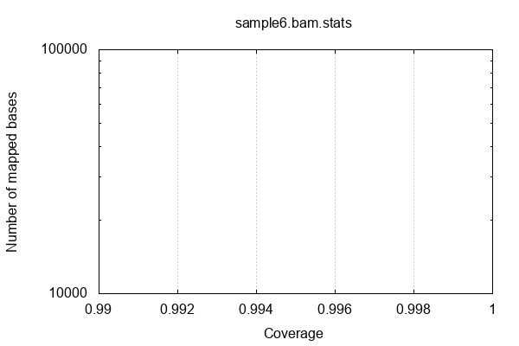
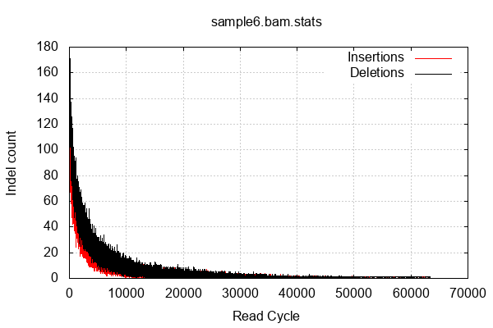
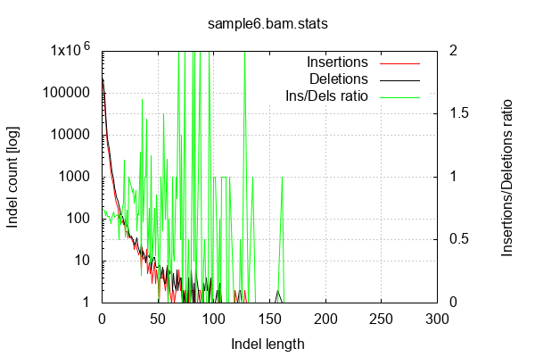
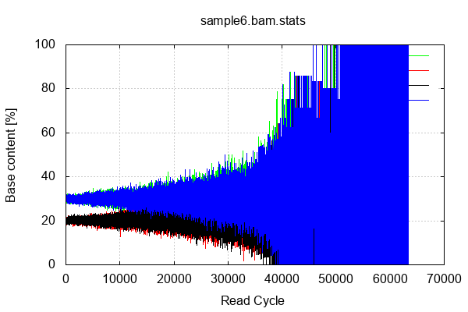
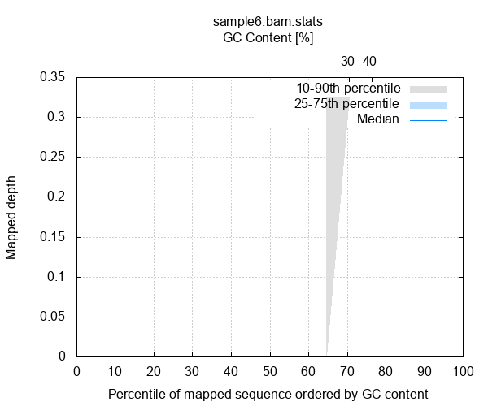
Results- Sequence 6

Slide 19
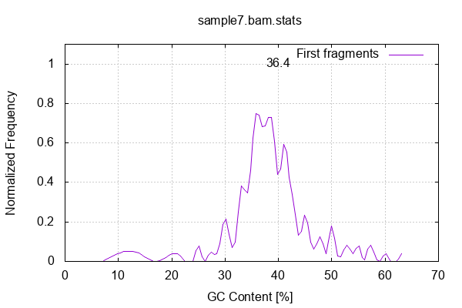





Results- Sequence 7

Slide 20






Results- Sequence 8

Slide 21






Results- Sequence 9

Slide 22






Results- Sequence 10

